Slide 1

Lambda Automation: Basics to Guru
Presented by Rich Morrow
1
Notes:
1

Slide 2
Today’s class slides & code are available at: https://github.com/rich-morrow/autom8d-basics-to-guru

Slide 3
Schedule – Day 1
S1: Introduction & Lambda basics (40 mins)
S2: Python & the Boto3 Library (30 mins)
A1: ACTIVITY: Authoring Lambda function in AWS Cloud9 IDE (30 mins)
BREAK: 10 mins
S3: Automating with Lambda (60mins)
A2: ACTIVITY: Automating tag enforcement with Lambda and AWS Config (50 mins)
Q&A (10 mins)

Slide 4
Schedule – Day 2
S4: Authentication & Authorization (30 mins)
S5: EC2 & IaaS Automation (50 mins)
A3: ACTIVITY: Automating EC2 log processing and alerting (50 mins)
BREAK: 10 mins
S6: Operations Automation (40mins)
A4: ACTIVITY: Automating Trusted Advisor and EventBridge alerts to update CloudWatch dashboards (50 mins)
Q&A (10 mins)

Slide 5
Schedule – Day 3
S7: Security Automation (50 mins)
A5: ACTIVITY: Automated WAF rule updates via GuardDuty finding notification (60 mins)
BREAK: 10 mins
S8: Governance, Regulation and Compliance (GRC) Automation (60 mins)
A6: ACTIVITY: Automated EC2 and S3 scanning and remediation using Inspector, Macie, and Lambda action (50 mins)Q&A (10 mins)
Q&A (10 mins)

Slide 6
Schedule – Day 4
S9: DevOps Automation (75 mins)
BREAK: 10 minutes
S10: Review of DevOps capstone lab (20 mins)
A7: ACTIVITY: Setting up a fully automated DevOps pipeline using Lambda triggers (105 mins)
Break (10 mins)
Course wrap up & next steps (20 mins)

Slide 7
Poll (single answer)
How much experience do you have with AWS Lambda?
Zero
Played with it a bit
Fairly proficient
Quite advanced

Slide 8
S1: Introduction to Lambda
Course outline & objectives
Value props of serverless
Lambda limits
Invocation methods (push, pull, direct invoke, scheduled action)
Basic anatomy of a Lambda function

Slide 9
Course Outline & Objectives
We WILL teach you:
Python, Lambda, AWS, Operations, Automation, GRC basics
Some AWS services. Namely: Cloud9, Lambda, AWS Config, IAM, EC2, TrustedAdvisor, EventBridge, CloudWatch, CloudTrail, S3, ELB, CloudFront, API Gateway, STS, VPC, Autoscaling, Systems Manager, Amazon Inspector, Secrets Manager.
We WILL NOT teach you:
In-depth Python, Lambda, AWS, Operations, Automation, or GRC.
In-depth AWS usage for ANY of these services, INCLUDING Lambda

Slide 10
Value props of Serverless
No “care and feeding” of infrastructure
Patching
Security
Monitoring
Networking
Scaling (Vertical -or- Horizontal)
Serverless architectures let you focus on your product, not your infrastructure.

Slide 11
Value Props: EC2 -vs- Containers -vs- Lambda
100 users
EC2 – “t2.nano”
20-30 sec
# of users served
10 users
Containers (ECS/EKS)
2-3 sec
< Sec
1 user
Serverless (Lambda)
response time
T₀ – Signal to Scale

Slide 12
Lambda Limitations & Limits
Can’t serve 3rd party apps (like Wordpress, MySQL, etc)
Both Containers & EC2 *can*, btw…
Lambda functions must execute in < 15mins
Though multiple Lambda functions can be tied together with Step Functions.
Lambda functions must consume < 10GB of memory
Invocation payload must be under 6MB
There are limitations around ports (like no SMTP) & low-level kernel calls.
Notes:
NOTE: AWS frequently changes limits around things like execution time & memory consumption. For the full list of current limits for AWS Lambda, check https://docs.aws.amazon.com/lambda/latest/dg/gettingstarted-limits.html
12

Slide 13






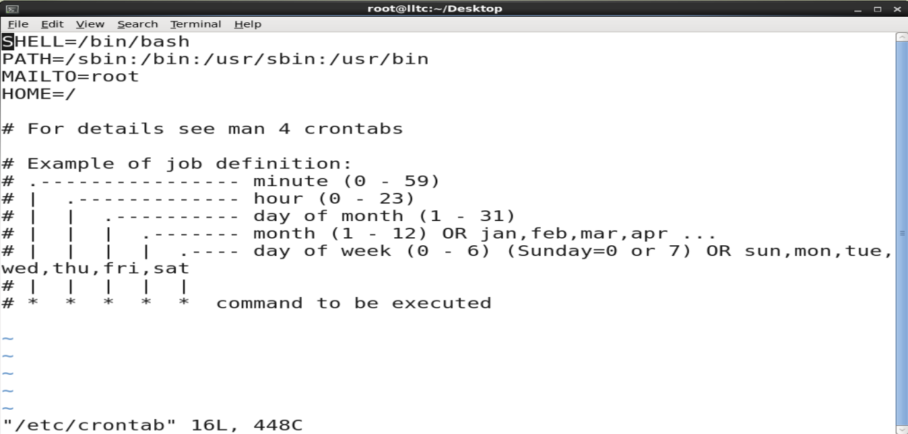
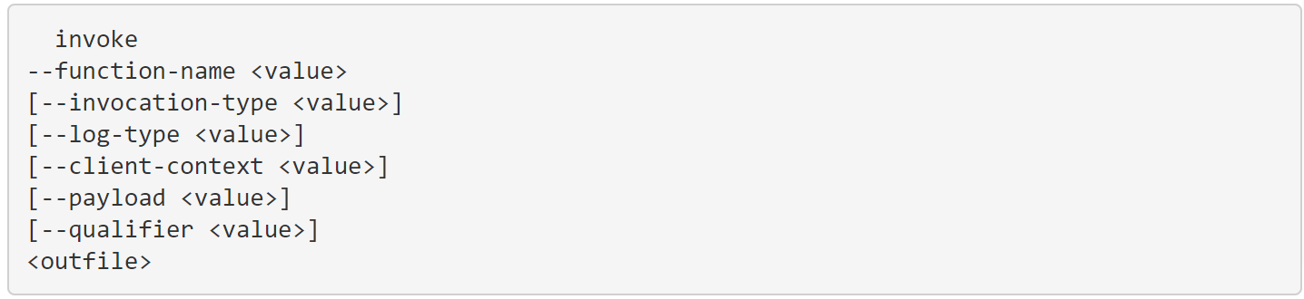
Lambda Invocation Methods
1) PUSH
“Hey Lambda, here’s some data”
2)PULL/POLL
“Hey <Svc X>, Have any data for me?”
Event Notifications
S3
SQS
SQS: GetRecords API Call
Lambda trigger
Lambda
Lambda
Lambda Subscription
SNS
DynamoDB Streams
3) SCHEDULED ACTION
4) DIRECT INVOCATION
-OR-
Can be synchronous or asynchronous
https://docs.aws.amazon.com/cli/latest/reference/lambda/invoke.html
Native Reoccuring
Raw crontab

Slide 14
Anatomy of a Lambda Function
def lambda_handler(event, context):
message = 'Hello {} {}!'.format(event['first_name'], event['last_name’])
return {
'message' : message
}
event: contains event data, like html form data. Example:
{ "first_name": "John", "last_name": "Smith" }
Would Return:
{ "message": "Hello John Smith!" }
context: provides info about the invocation, function & execution environment. Example:
print("Lambda function ARN:", context.invoked_function_arn)
print("CloudWatch log stream name:", context.log_stream_name)
print("CloudWatch log group name:", context.log_group_name)
print("Lambda Request ID:", context.aws_request_id)
print("Lambda function memory limits in MB:", context.memory_limit_in_mb)
# We have added a 1 second delay so you can see the time remaining in get_remaining_time_in_millis. time.sleep(1)
print("Lambda time remaining in MS:", context.get_remaining_time_in_millis())
Handler: the entry point where you function starts processing.
Note on naming: Handler name is derived from:
The name of the file in which the handler function is located
The name of the Python handler function.
Default name in the console is just “lambda_handler”.
IMPORTANT: Code inside than handler is executed on each function call, code outside the handler is executed only on “cold starts” (Luckily for us, Python and Node.js are the fastest to start)
Notes:
Python handler examples from AWS Documentation at https://docs.aws.amazon.com/lambda/latest/dg/python-handler.html
Context examples from AWS Documentation at https://docs.aws.amazon.com/lambda/latest/dg/python-context.html
Details on cold starts: https://dashbird.io/knowledge-base/aws-lambda/cold-starts/
14

Slide 15
Poll (single answer)
How much experience do you have with AWS?
Zero
A few months
A few years
Extensive (been a main function of my job for years)

Slide 16
S2: Python & the Boto3 Library
Python’s suitability for scripting, AWS, Lambda
Python basics
Advantages of Boto3
Review of Lambda basics

Slide 17
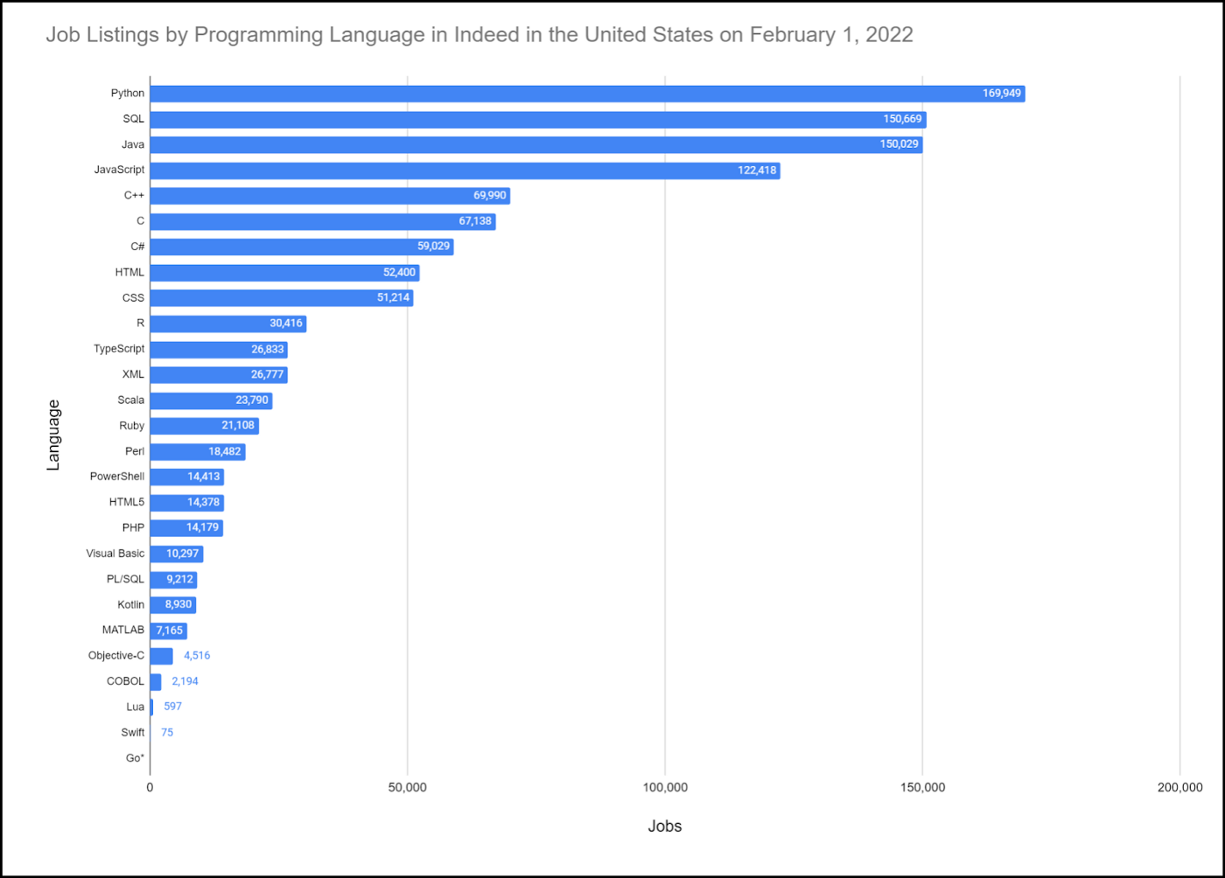

Python’s suitability for scripting, AWS, Lambda
Scripting:
Syntactically terse.
Versatile (esp in Machine Learning & Data Science w/tools like Pandas, NumPy and Jupyter Notebooks).
It’s Popular! Lots of sysadmins already use it!
AWS:
Lots of code examples.
Lots of native support in services like CodeGuru, CDK, SDK, etc.
Lambda:
Fastest cold start time of any Lambda languages.
Lots of docs, tutorials, quickstarts in Python.

Slide 18
Python basics
Basic data types: numbers (floating point, complex, and unlimited-length long integers), strings (both ASCII and Unicode), lists, and dictionaries.
Supports object-oriented programming with classes and multiple inheritances.
Supports raising and catching exceptions (cleaner error handling).
Data types are strongly and dynamically typed. Mixing incompatible types (e.g. attempting to add a string and a number) causes an exception to be raised, so errors are caught sooner.
Automatic memory management (garbage collection)
Uses PEP code style rules (indentation sensitive, 4 spaces per level)
Notes:
Python beginners guide at: https://wiki.python.org/moin/BeginnersGuide/Overview
PEP 8 Style Guide: https://wiki.python.org/moin/BeginnersGuide/Overview
18

Slide 19
A basic Python program
# NOTE: It’s common to import external libraries. Imports always go at top of the file, but this program is basic - we don’t have any
# Functions are the core of what we do in Python, let’s define two…
def add(num1, num2):
return num1 + num2
def subtract(num1, num2):
return num1 - num2
# Send some txt to stdout to instruct the user what to do
print("Please select operation -\n" \
"1. Add\n" \
"2. Subtract\n")
# Accept input from the user
select = int(input("Select operations form 1, 2:"))
# Do sanitization of input data (convert to integer)
number_1 = int(input("Enter first number: "))
number_2 = int(input("Enter second number: "))
# perform some basic logic to add, subtract or return error
if select == 1:
print(number_1, "+", number_2, "=",
add(number_1, number_2))
elif select == 2:
print(number_1, "-", number_2, "=",
subtract(number_1, number_2))
else:
print("Invalid input")
Recommended: Python Cheat Sheets

Slide 20
Boto3 Library
Basically, the AWS SDK for Python
Allows for CRUD, operating and maintaining of AWS services
Provides ‘waiters’ which poll for resource status changes
Aggressively maintained by AWS
Excellent documentation
Two options for usage:
Client API (low level 1:1 mapping of method:underlying API, when control is needed)
Resource API (high level, provides more developer productivity)

Slide 21
Boto3 examples
#upload file to S3 (resource API automatically determines when to do multi-part!)
import boto3
s3 = boto3.resource('s3')
s3.meta.client.upload_file('source_file_name.html', 'my.bucket.com', 'aws_file_name.html', ExtraArgs={'ContentType': "application/json", 'ACL': "public-read"} )
#step through all EC2s, restart any stopped (resource API allows iteration over collections!)
for i in ec2.instances.all():
if i.state['Name'] == 'stopped’:
i.start()
#filter cloudwatch event rule, listing Alarms (client API allows override of Region)
import boto3
AWS_REGION = "us-west-2“
client = boto3.client('events', region_name=AWS_REGION)
response = cloudwatch.list_rules(
NamePrefix='Alarm’
)
print(response)

Slide 22
More Boto3 examples
#count visits to ‘some-web-page’ over Q1. This would assume some previously created custom CloudWatch metric ‘Number of visits’ in the Namespace ‘Web Traffic’
import boto3
from datetime import datetime
AWS_REGION = "us-west-2“
client = boto3.client('cloudwatch', region_name=AWS_REGION)
response = client.get_metric_data(
MetricDataQueries=[
{
'Id': 'identifier’,
'MetricStat’: {
'Metric': { 'Namespace': 'Web Traffic’,
'MetricName': 'Number of visits’,
'Dimensions’: [
{
'Name': 'page’,
'Value': ‘some-web-page.html’
}
]
},
'Period': 300,
'Stat': 'Sum’,
'Unit': 'Count’
}
},
],
StartTime=datetime(2022, 1, 1),
EndTime=datetime(2022, 3, 31)
)
print(response)
print(sum(response['MetricDataResults'][0]['Values']))

Slide 23
Review of Lambda Basics
Lambda can work with other languages than Python!
Can use multiple editors (we’ll primarily use AWS native Cloud9 IDE)
Can (and should) use Layers to include external packages
Reusable
Allow centralized, common control over packages
Reduce deployment package size
All code & dependencies contained in a zipfile
State Machines (combinding multiple Lambdas & other svcs) can be constructed from AWS Step Functions

Slide 24
Activity 1: Real world Lambda function in Cloud9 IDE
Authoring a Lambda function
Testing
Running in the Cloud9 IDE
Q&A

Slide 25
Break! (10 mins)

Slide 26
Poll (single answer)
How much experience do you have with automation (bash, python, powershell, etc)?
Zero
A few months
A few years
Extensive (it’s a main function of my job)

Slide 27
S3: Automating with Lambda
Advantages of automation
Using Tags effectively
Use cases in CI/CD, security, governance, regulation, compliance, operations
High-level walkthrough of 12-15 innovative, practical use cases for Lambda automation across those domains
How to identify opportunities for automation in your unique role

Slide 28
Advantages of automation
Your time is precious!
You’re not good at repetitive tasks (but your computer sure is!)
Version Control
Audit Trails
Repeatable, Reliable, Reusable, Scalable, Consistent
NOTE: Lambda is only ONE of the tools to automate…
Systems Manager Automation Playbooks, CloudFormation are other tools. And many services have native automation hooks

Slide 29
Tags in AWS
Tags are just “key : value” pairs. Like: “owner : me@email.com” that we assign to resources (like EC2).
They serve 4 main purposes:
Access Control: Tag an EC2 with “env = prod” & then set Developers group to DENY all actions on “env != dev”.
Filtering: Tag your Lambdas with “owner = me@email.com” & then quickly find your handful of functions in the console.
Billing: Tag your resources with “cost-center = application-xyz” & then roll up total AWS costs for just your app.
Automation: Tag an EBS disk with “grc-level = pci-1” & then set up automation to ensure all these tagged disks are encrypted.

Slide 30
Using Tags effectively
AWS allots 50 tags / resource
Use 10-15 for company wide purposes (billing, access control, escalations to resource owner, etc)
Use remainder for application or department-specific needs
Creating (and enforcing) a tag topology is job #1 in AWS!!!
Enforcement can happen at resource creation time -AND- on an ongoing basis.

Slide 31
Lambda Security Automation
DevSecOps (sniff for secrets, run SCA, enforce policies in SGs, WAF, ELBs, VPCs, etc)
Enforce security Tag policies (encryption at rest/wire, “env=dev|test|prod”, VPC, SG req’d tags, etc)
AWS Foundational Security Best Practices controls
Security-related Lambda scripts from the AWS Security Blog
Notes:
SCA: Static Code Analysis
SG: Security Group
WAF: Web Application Firewall
31

Slide 32
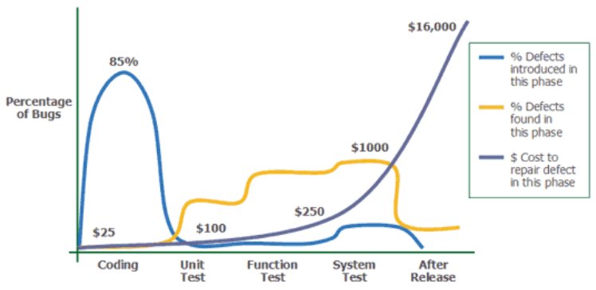

“Shift left” – the whole point of CI/CD
Source: Applied Software Measurement, Capers Jones, 1996
Notes:
Image credit: https://medium.com/at-internet/how-to-combine-testing-and-agile-method-2a990d70108f
…and if you want to read more from Capers Jones, here’s a link to his catalog on Amazon.com: https://www.amazon.com/Capers-Jones/e/B000APTHHW%3Fref=dbs_a_mng_rwt_scns_share
32

Slide 33



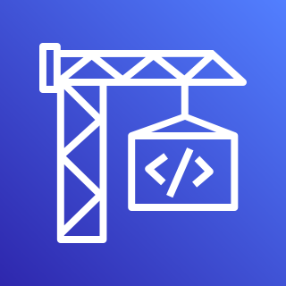
DevSecOps
1.
2.
3.
Developers
AWS CodeCommit
Lambda Security
Checks
AWS CodeBuild
Code Commited
Secrets (AK/SK, etc) sniff
Static Code Analysis
Look up Config (possibly tag-based)
Enforce WAF rules
Enforce SG policies
Enforce ELB Security
Enforce VPC setup
…and more!
Continue Build, Test, Deploy…

Slide 34
Lambda & Security Hub Integration!
Remediate Security Hub findings
Security, Orchestration, Automation, Response (SOAR) Workflows
Dynamically update WAF/SG/DNS policies via Firewall Manager Automations
Alert / remediate Access Analyzer or CloudTrail issues
EC2 telemetry via Amazon Inspector
Trusted Advisor recommended best practices
AWS Security Hub Automated Response and Remediation

Slide 35
Lambda GRC Automation 1
Combine with AWS Config Rules to alert / remediate resource misconfigurations
Publicly exposed S3 resources (via Access Analyzer)
Mistakenly open SGs
Service-level logging disabled / misconfigured

Slide 36
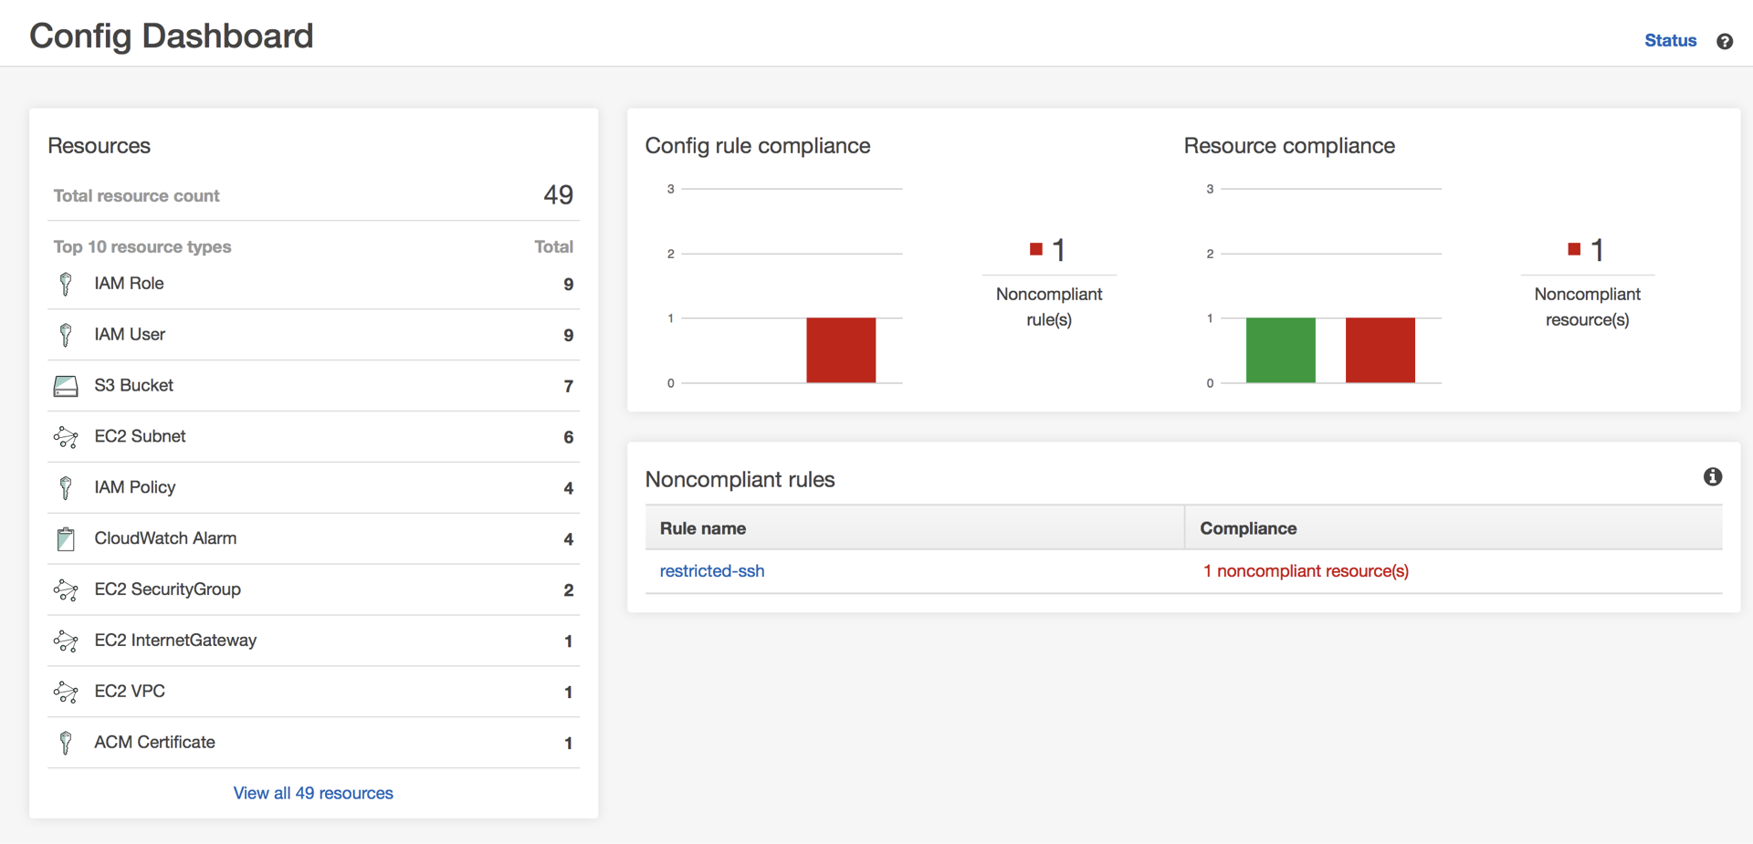
AWS Config dashboard compliance

Slide 37
Lambda GRC Automation 2
Logfile processing or validation (CloudTrail, S3/ELB access logs, other audit logs)
EC2 instance compromise (via GuardDuty and/or Inspector)
RDP / SSH brute force
Bitcoin activity
Unusual activity (instance launch, remote server access, etc)
Unauthorized, unpatched software or users on instance
AWS Compliance Center!
NOTE: Make sure Lambda passes GRC requirements!

Slide 38
Lambda Operations Automation
Identify then downscale or turn off resources (EC2, ECR, Redshift, etc) when unneeded/unused
Automate CI/CD pipelines
IoT device management
Alert, remediate operational issues
Resource scarcity (EC2 memory, CPU, etc)
Security issues (via Security Hub)
Event stream processing (sourced from EventBridge, Kafka, etc)

Slide 39
When to Automate?
Any time you’ve done something a 2nd, 3rd time.
When time criticality (GRC, security exposure, resource scarcity) is of utmost importance.
Downsizing, shutting off unneeded or unused resources.
DevOps toolchains, CI/CD pipelines.
Metrics & monitoring alerts & remediations.
Tag enforcement!

Slide 40
Break! (10 mins)

Slide 41
Activity 2: Automating tag enforcement with AWS Lambda and AWS Config
Tag configuration
Basics of AWS Config
AWS Config parameterization of tagging
AWS Config enforcement of tagging
Validation of tagging enforcement

Slide 42

EOD Q&A

Slide 43
Schedule – Day 2
S4: Authentication & Authorization (30 mins)
S5: EC2 & IaaS Automation (50 mins)
A3: ACTIVITY: Automating EC2 log processing and alerting (45 mins)
BREAK: 10 mins
S6: Operations Automation (40mins)
A4: ACTIVITY: Automating GuardDuty and EventBridge alerts to update CloudWatch dashboards (45 mins)
Q&A (10 mins)

Slide 44
Poll (single answer)
How much experience do you have with AWS IAM?
Zero
A few months (can read a basic PD)
A few years (can write advanced PD)
Extensive (it’s a main function of my job)

Slide 45
S4: Authentication & Authorization
Review of IAM.
Review of Logging services (CloudTrail, S3 Logs, ELB Logs, CloudFront Logs, API Gateway Logs).
Utilizing STS Roles.

Slide 46






Review of IAM
have
AK/SK
(long term)
STS
(short term)
User
App
Role
Credentials
have
Principals
A Principal accesses a Resource (via SDK, CLI, Console or REST API)
Credentials are validated
Permissions (both principal and/or Resource) are checked
Access is granted or denied
CloudTrail (if enabled) logs outcome
Policy Document
Permissions
Notes:
NOTE: This is GREATLY simplified! Policy evaluation logic is a whole lot more complex in AWS. Here’s the skinny: https://docs.aws.amazon.com/IAM/latest/UserGuide/reference_policies_evaluation-logic.html
46

Slide 47
Policy Document examples
{
"Statement": [
{
"Effect": "Allow",
"Action": “s3:*,dynamodb:*",
"Resource": "*",
"Condition": {
"DateGreaterThan": {"aws:CurrentTime": "2022-01-01T00:00:00Z"},
"DateLessThan": {"aws:CurrentTime": "2022-03-31T23:59:59Z"}
}
}
]
}
Allow all S3, DDB API calls for 2022 Q1
AWS Policy Generator
REQUIRED
OPTIONAL
Allow attach/detach of EBS volume to specific EC2
{
"Statement": [
{
"Effect": "Allow",
"Action": [“ec2:AttachVolume", “ec2:DetachVolume“],
"Resource": [ "arn:aws:ec2:*:*:volume/*", "arn:aws:ec2:*:*:instance/*" ],
"Condition": {
"ArnEquals": {"ec2:SourceInstanceARN": "arn:aws:ec2:*:*:instance/instance-id"}
}
}
]
}

Slide 48
IAM permissions for Lambda
Event Notifications
S3
Requires Lambda invoke permissions
Lambda
DDB:PutItem(x)
“upstream svc invoking lambda”
DynamoDB
Requires Lambda execution role
Lambda Resource-side Policy:
“lambda executing API call on downstream svc”
"Statement": [
{
"Effect": "Allow",
"Principal": { "Service": "s3.amazonaws.com" },
"Action": "lambda:InvokeFunction",
"Resource": "arn:aws:lambda:us-east-2:123456789012:function:my-function",
"Condition": {
"StringEquals": { "AWS:SourceAccount": "123456789012" },
"ArnLike": { "AWS:SourceArn": "arn:aws:s3:::my-bucket" }
}
}
]
Roles have 2 parts:
Role with PD (permission)
Trust relationship to allow principal (Lambda) to assume role
Notes:
For more info on Lambda execution roles, see https://docs.aws.amazon.com/lambda/latest/dg/lambda-intro-execution-role.html
48

Slide 49
Lambda Execution role for DDB
Role with PD (permission)
Trust relationship (trust-policy.json)
{
"Version": "2012-10-17",
"Statement": [
{
"Effect": "Allow",
"Action": [
"dynamodb:PutItem",
"logs:CreateLogGroup",
"logs:CreateLogStream",
"logs:PutLogEvents",
],
"Resource": "*"
}
]
}
{
"Version": "2012-10-17",
"Statement": [
{
"Effect": "Allow",
"Principal": {
"Service": "lambda.amazonaws.com“
},
"Action": "sts:AssumeRole“
}
]
}
aws iam create-role --role-name lambda-ex \n
--assume-role-policy-document file://trust-policy.json
aws iam attach-role-policy --role-name lambda-ex --policy-arn arn:aws:iam::aws:policy/service-role/NameOfLambdaRoleYouCreatedInStep1

Slide 50
Logging Services in AWS
CloudTrail: Logs all GA’d service API calls
Access Logs:
S3
ELB (Application and Network Load Balancers only)
CloudFront CDN
API Gateway
KMS
NOTE: ALL of these logs must be turned on!

Slide 51
STS Roles in IAM
User-configurable (15m – 36h) forced expiration (temporary access ONLY)
Behind Federated access (internal users – SAML, SSO, AD/LDAP), Amazon Cognito (end users), Roles (esp EC2, ECS/EKS [svc and task], Lambda), S3/CloudFront short-term signed URLs & other time-limited AWS access.
Preferred over long term AK/SK credentials
More secure
Roles need no hardcoded credentials

Slide 52
Poll (single answer)
How comfortable are you with EC2?
I can spell it ☺
Basic proficiency (basic EBS, SG, ENI, VPC config)
Advanced proficiency (advanced networking, security)
Extensive (it’s a main function of my job)

Slide 53
S5: EC2 & IaaS Automation
Challenges of EC2 environment (telemetry on the instance, limitations of AWS-level visibility into server internals).
Review of EC2-related services (VPC, Autoscaling, EBS, Systems Manager, Inspector, Secrets Manager, CloudWatch, EventBridge).
Review of EC2 and Autoscaling hooks.
Review of EC2 Lab.

Slide 54
Challenges of EC2
No native AWS API access to internals of server!
AWS Systems Manager (SSM) can help.
Limited CloudWatch visibility into internal metrics (no RAM utilization metric, for example).
Unique security concerns:
Remote access via SSH / RDP (probably biggest attack vector).
Ongoing patching (of OS, packages) required.
Need permissions to interact w/other AWS services.
It’s “true” IaaS. Wait… what’s IaaS?

Slide 55
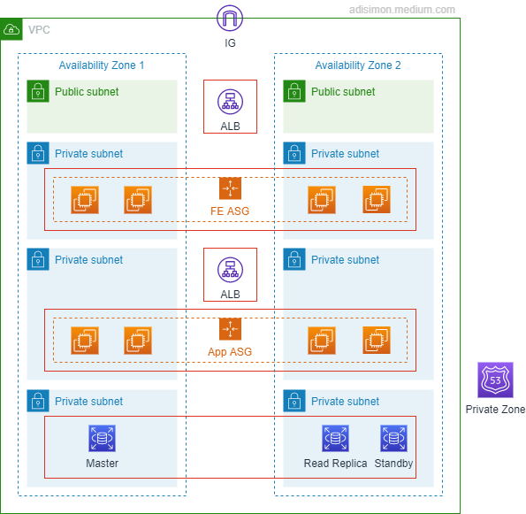
IaaS -vs- PaaS -vs- SaaS
Software aaS – think Office 365, Salesforce G’Apps…
Control Convenience
“non-tecchies point and click to configure app”
AWS Web Console!
Platform aaS – GCP & Azure started here
“Point and click custom app deployment & mgmt”
AWS: Elastic Beanstalk
Infrastructure aaS – 95% of what AWS offers is this!
“lego building blocks” -- You gotta know intricacies of each piece
But some folks say only “VMs” (AWS: EC2) are IaaS… I disagree, BTW…

Slide 56







EC2 Internals
Security group
“point & click firewall”
CW Agent
AWS Systems Manager
Amazon CloudWatch
SSM Agent
NAT gateway
Inspector
Elastic network interface
EC2 Instance
H/W ½ (instance type)
S/W ½ (Amazon Machine Image) or “AMI”
May have local (ephemeral) disk
At least one NIC card (ENI)
EBS Volume
Elastic IP address
Amazon Inspector

Slide 57



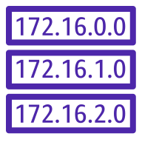





EC2 Ecosystem
Internet
VPC
Internet gateway
Availability Zone 1
Availability Zone 2
NAT gateway
NAT gateway
Public subnet
Public subnet
Route table
Application Load Balancer
Route table
NAT Gateway
NAT Gateway
Auto Scaling group
Private subnet
Private subnet
Route table
Route table
EC2 Instance
EC2 Instance

Slide 58









AWS Systems Manager
Automation
Documents
Patch Manager
Parameter Store
Run Command
Inventory
Maintenance Windows
State Manager
…And LOTS More
OpsCenter

Slide 59
Amazon Inspector
“Automated , continual vulnerability management at scale”
Agent-based (white box) and agent-less (black box)
Works with EC2, Containers
Calculates contextualized “risk score” based on CVE info
Has own console, and Security Hub integration
Can be used with EventBridge to automatically generate tickets and start remediation workflows
Notes:
https://aws.amazon.com/inspector/?nc=sn&loc=0
59

Slide 60


AWS Secrets Manager
“Rotate, manage, retrieve DB creds, API keys and other secrets”
Very useful for database credentials
Secrets Manager
Creds Rotation
App
EC2/OP svr
Database
Notes:
AWS Security Blog on using lambda with Secrets Manager & credentials rotation: https://aws.amazon.com/blogs/security/how-to-securely-provide-database-credentials-to-lambda-functions-by-using-aws-secrets-manager/
60

Slide 61

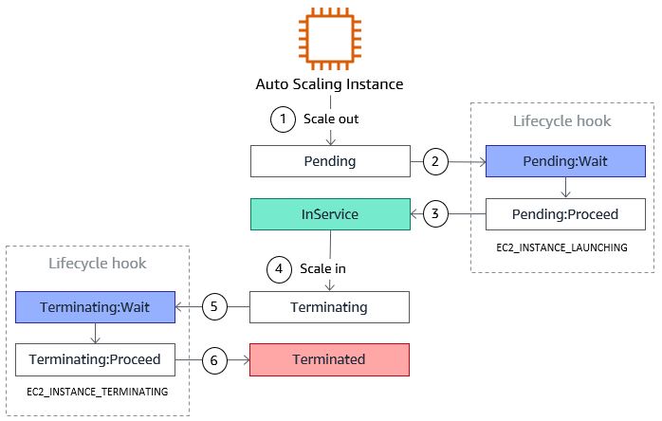
EC2 Auto Scaling Lifecycle Hooks
Used for:
Bootstrapping
Notifications
Cleanup

Slide 62
Activity 3: Automating EC2 log processing and alerting
Configuration of EC2 logs and CloudWatch agent
Coding Lambda log processor
Route particular log entries to Lambda with a CloudWatch Subscription Filter
Reviewing log processing events & alerts

Slide 63
Break! (10 mins)

Slide 64
Poll (single answer)
What percentage of your job is operations?
0-10%
10-30%
30-50%
Half or more

Slide 65
S6: Operations Automation
Common opportunities for automating operational issues.
Review of AWS operations services (Trusted Advisor, EventBridge, CloudWatch Dashboards).
Review of Operations Lab.

Slide 66
Operations Automation
Health checks, notifications, and resolution
Resource scarcity (EBS volume resizing)
Cost-saving via right-sizing of AWS infrastructure
Automating start/stop of resources
Dashboard creation
Dynamic serverless dashboards in S3 with AJAX Lambda hooks
Security automation
Tag-based GRC Compliance
Notes:
https://aws.amazon.com/inspector/?nc=sn&loc=0
66

Slide 67

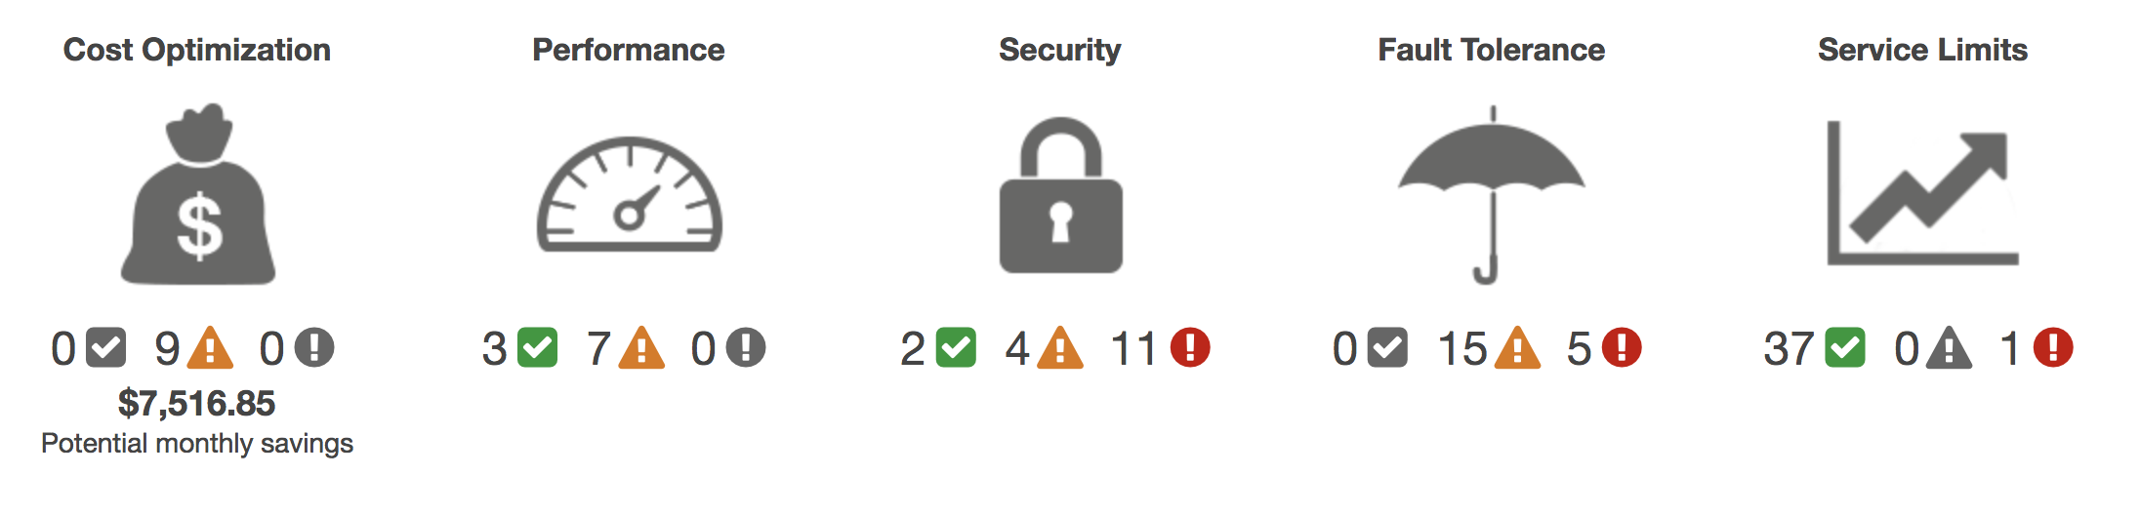
AWS Trusted Advisor
Real-time TA status monitoring…

Slide 68

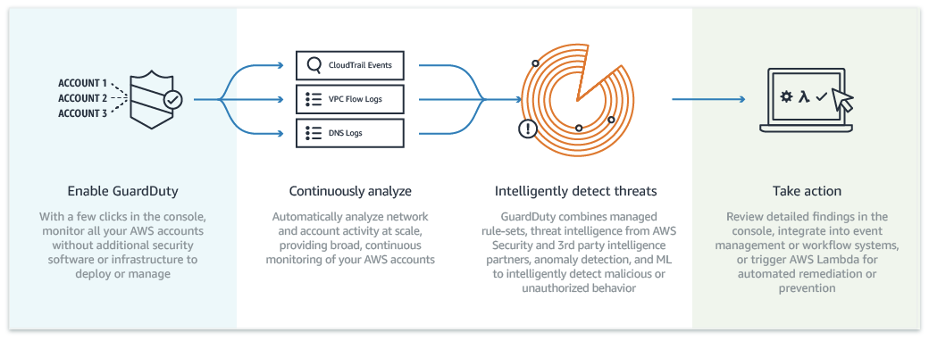
Amazon GuardDuty

Slide 69

Amazon EventBridge
“Serverless event bus to build event-driven apps at scale”
Events can be generated from:
AWS Services (+cross acct, region) – 90+ svcs as sources, 17 as targets
Your Apps
3rd party SaaS sources like Zendesk or Shopify (21+ native SaaS integrations, SaaS events travel AWS network, not pub)
Notes:
69

Slide 70
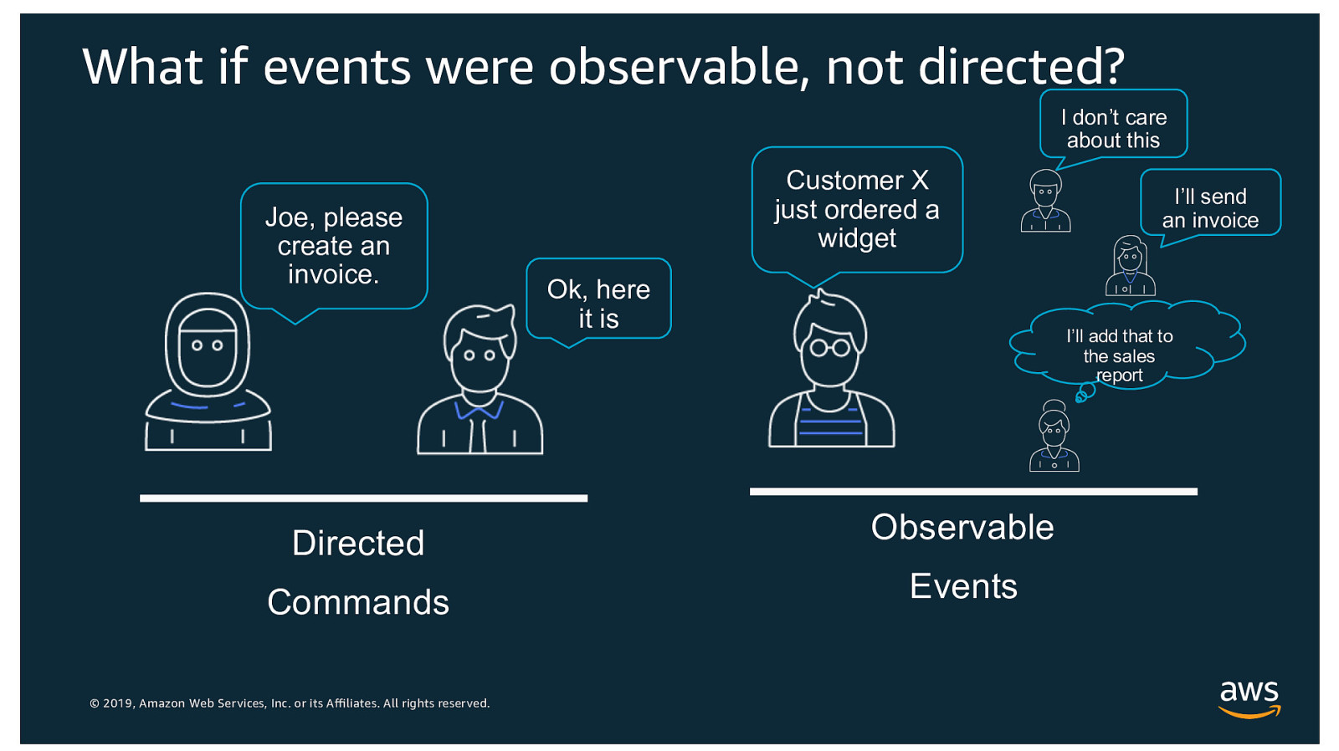
EventBridge: Directed vs Observable
Notes:
AWS “Intro to Amazon EventBridge” https://www.youtube.com/watch?v=TXh5oU_yo9M
70

Slide 71
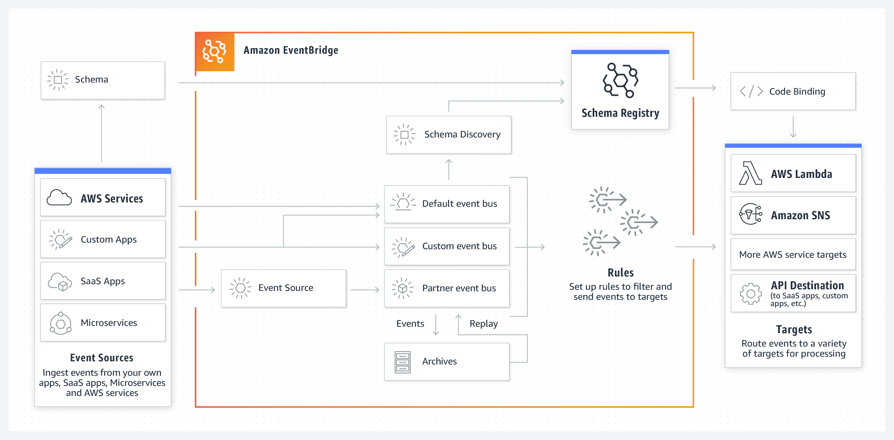
EventBridge Architecture
Notes:
AWS “Intro to Amazon EventBridge” https://www.youtube.com/watch?v=TXh5oU_yo9M
71

Slide 72
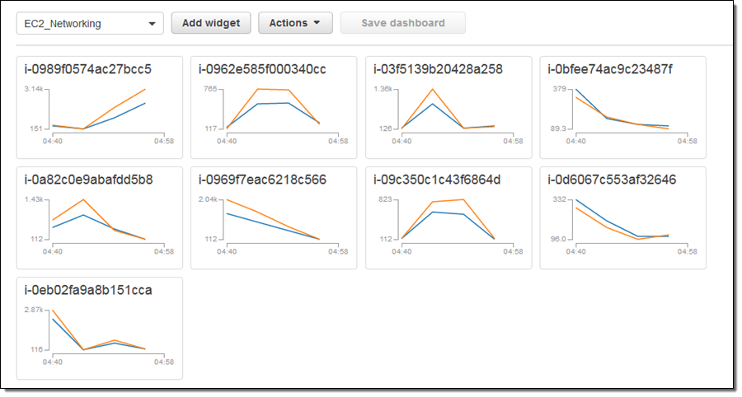
CloudWatch Dashboards
Display graphs & widgets (cross acct & region)
Notes:
CloudWatch dashboard creation tutorial: https://aws.amazon.com/blogs/aws/new-api-cloudformation-support-for-amazon-cloudwatch-dashboards/
72

Slide 73
Activity 4: Automating GuardDuty and EventBridge alerts to update CloudWatch dashboards
Building a simple CloudWatch Dashboard
Integrating GuardDuty findings into basic CW Dashboard
Updating CW Dashboards with real time EventBridge updates

Slide 74
EOD Q&A

Slide 75
Schedule – Day 3
S7: Security Automation (50 mins)
A5: ACTIVITY: Automated WAF rule updates via GuardDuty finding notification (60 mins)
BREAK: 10 mins
S8: Governance, Regulation and Compliance (GRC) Automation (60 mins)
A6: ACTIVITY: Automated EC2 and S3 scanning and remediation using Inspector, Macie, and Lambda action (50 mins)Q&A (10 mins)
Q&A (10 mins)

Slide 76
S7: Security Automation
Review of AWS Security services (AWS WAF, AWS Config, Guard Duty, KMS, Detective).
Review of Security Activity.

Slide 77
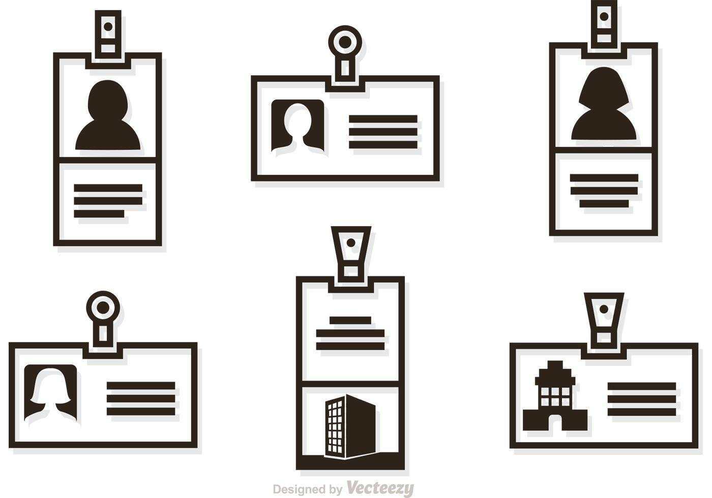


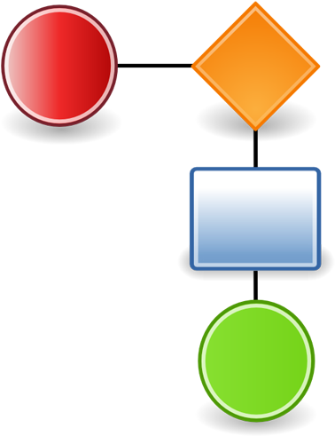

AWS’ Toolkit to Detect->Protect->Respond
Identity
Detection
Infrastructure
Protection
Storage
Protection
Response
Infrastructure
Protection
Identity and Access Management (IAM)
AWS Organizations
AWS Secrets Manager
AWS CloudTrail
Amazon CloudWatch
AWS Config
Amazon Detective
Amazon GuardDuty
AWS Security Hub
VPC flow logs
AWS Firewall Manager
Amazon Inspector
AWS Shield
AWS Systems Manager
AWS WAF
AWS Cloud HSM
AWS KMS
Amazon Macie
Server-side encryption (KMS-backed)
Client-side encryption (always possible)
AWS Config rules
AWS Lambda
AWS Systems Manager (Automation Documents)
…we’ll look at all of these services!
Notes:
Image credit: https://www.clipartmax.com/
77

Slide 78
Poll (single answer)
How much of your role is security focused?
Zero
< 10%
10-30%
30-50%
North of 50%

Slide 79

AWS WAF
“THE BEST ‘front door’ DDOS protection for your apps”
Protects against common web exploits such as:
Layer 7 inspection and filtering for OWASP, CVE, etc
SQL Injection
Cross-site scripting (xss)
AWS and 3rd party Managed rules available
Deploys to CloudFront CDN, ALB, API Gateway, Firewall Manager…
API capabilities provide infinite automation possibilites

Slide 80
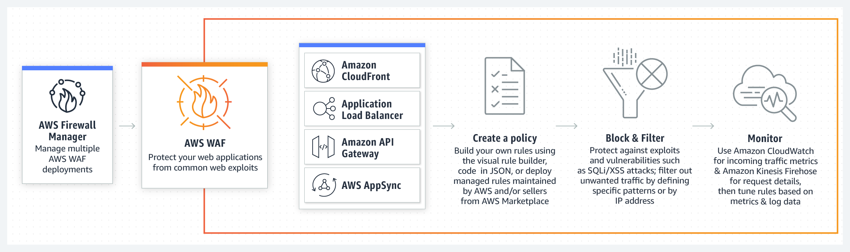
AWS WAF: High Level

Slide 81
AWS WAF: Details
Web traffic filtering: Custom or managed rule sets to block traffic on L7 entities.
Bot Control: Mgd rule group for common bots like scrapers, crawlers, etc.
Account takeover fraud prevention: Mgd rule group which monitors console login page for unauthorized access.
Full-featured API: Can be triggered via Lambda, AWS CLI, etc.
CloudWatch integration: Real-time metrics & alerting on IP addresses, geo locations, User-Agents, Referrers for alerting on specific attacks.

Slide 82

AWS Config
“Discover initial inventory/configuration and continually capture / be alerted to config changes of your AWS resources”
Review relationships (like SG “xyz” is used by these 14 EC2s)
View config change histories
Config Rules (mgd & custom) allow for:
Automated alerting and remediation of “drift”
Use of SSM Automation documents -or- Lambda functions
Use of conformance packs
Works cross-account, cross-Region, with Organizations

Slide 83
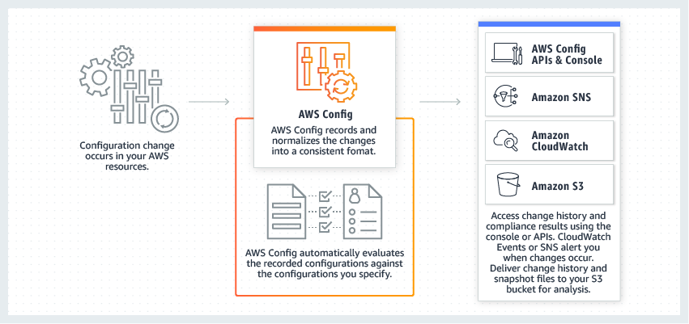
AWS Config: High Level

Slide 84
AWS Config dashboard compliance
…and lots more

Slide 85
Amazon GuardDuty
“Intelligent, organization-wide threat detection with just a few clicks”
Ingests CloudTrail, VPC Flow Logs, and DNS logs and runs machine learning over them in order to detect:
AWS Account Compromise:
Known malicious IP, Unusual traffic volume, DNS exfiltration, anonymizing proxy
Instance Compromise:
RAT (Remote Access Trojan) installed, bitcoin activity, connection to known bad actor site, RDP brute force, unusual port activity
Malicious Reconnaissance:
Temp creds used off-instance, unusual remote IP caller, unusual instance launch, account compromise attempt

Slide 86
Amazon GuardDuty: High Level

Slide 87
Amazon GuardDuty: Use Cases
Block unauthorized activity
Compromised credentials
Unusual S3, EC2, Account access
Malicious remote up and downstream communication
Enable continuous monitoring and analysis
Simplify forensics (integration with Amazon Detective)
Automated threat response
APIs, CLIs, EventBridge hooks to Lambda sinks

Slide 88

AWS KMS
“AWS-managed, Customer-configured, multi-tenant, serverless cryptographic key creation and management”
Native integration to dozens of AWS services like S3, EBS, DynamoDB, et al.
“Master keys” never leave the device
Key material can be imported (but not exported), and multi-Region deployments supported
Can “front” the single-tenant Cloud HSM for native integration with AWS services & single-tenant GRC compliance of Cloud HSM where required
Notes:
For details on KMS features, check https://aws.amazon.com/kms/features/
88

Slide 89
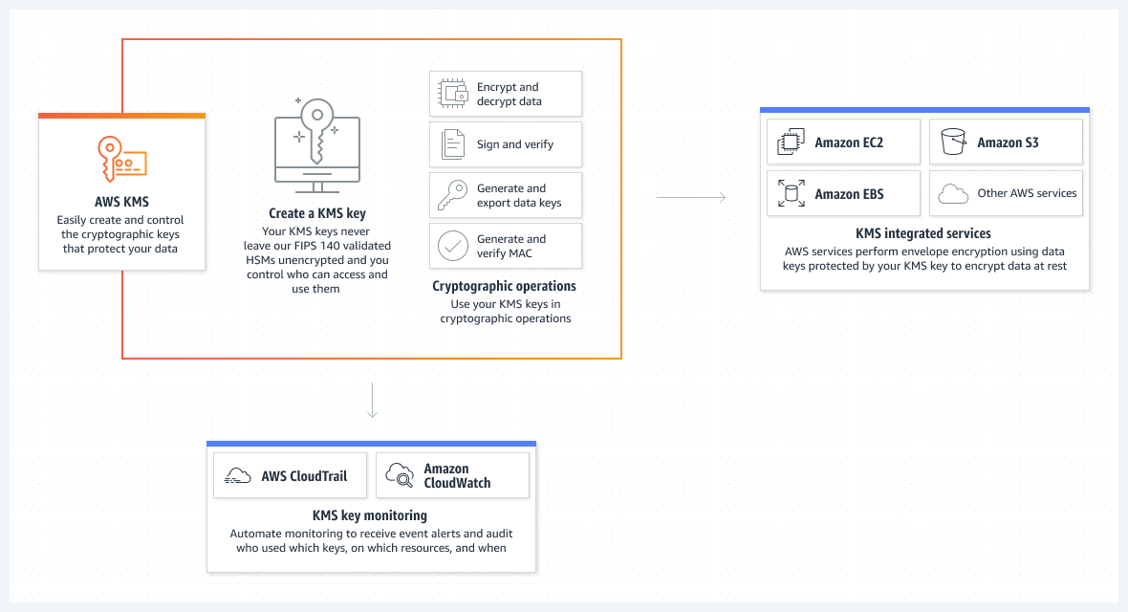
AWS KMS: High Level

Slide 90






Asymmetric Data Key Encryption
kms.GenerateDataKeyPair
Your App
S3 Bucket
Master Key
Data Keys
KMS
Notes:
Image attribution: https://www.vecteezy.com/vector-art/581808-lock-icon-vector-illustration
90

Slide 91
Asymmetric Data Key Encryption
Your App
S3 Bucket
Master Key
Data Keys
KMS
Notes:
Image attribution: https://www.vecteezy.com/vector-art/581808-lock-icon-vector-illustration
91

Slide 92
Asymmetric Data Key Encryption
Your App
S3 Bucket
Master Key
Data Keys
KMS
Notes:
Image attribution: https://www.vecteezy.com/vector-art/581808-lock-icon-vector-illustration
92

Slide 93
Asymmetric Data Key (De)cryption
Your App
S3 Bucket
kms.decrpyt
Master Key
Data Keys
KMS
Notes:
Image attribution: https://www.vecteezy.com/vector-art/581808-lock-icon-vector-illustration
93

Slide 94

Asymmetric Data Key (De)cryption
Your App
S3 Bucket
Master Key
Data Keys
KMS
Notes:
Image attribution: https://www.vecteezy.com/vector-art/581808-lock-icon-vector-illustration
94

Slide 95
Asymmetric Data Key (De)cryption
Your App
Did you notice?
Master Key *never* leaves KMS (it’s can’t)
We control what a single data key encrypts (and can limit it’s blast radius if compromised)
KMS *never* decrypts *data*, so it stay’s fast (and performant)
KMS doesn’t store the data keys – we do
S3 Bucket
Master Key
Data Keys
KMS
Notes:
Image attribution: https://www.vecteezy.com/vector-art/581808-lock-icon-vector-illustration
95

Slide 96

AWS Detective
“When you need a deep-dive, unified, contextually relevant, interactive view of your resources, users and interactions between them in order to isolate the root cause of a security issue”
Contextually relevant: Helps answer questions like “is it normal for this role to have so many failed API calls?” or “is this spike in traffic on this instance expected?”
Interactive view: (Constantly) organizes TB of data into configurable visual graph summaries with links to logs & other AWS service details for triage or threat hunting.

Slide 97
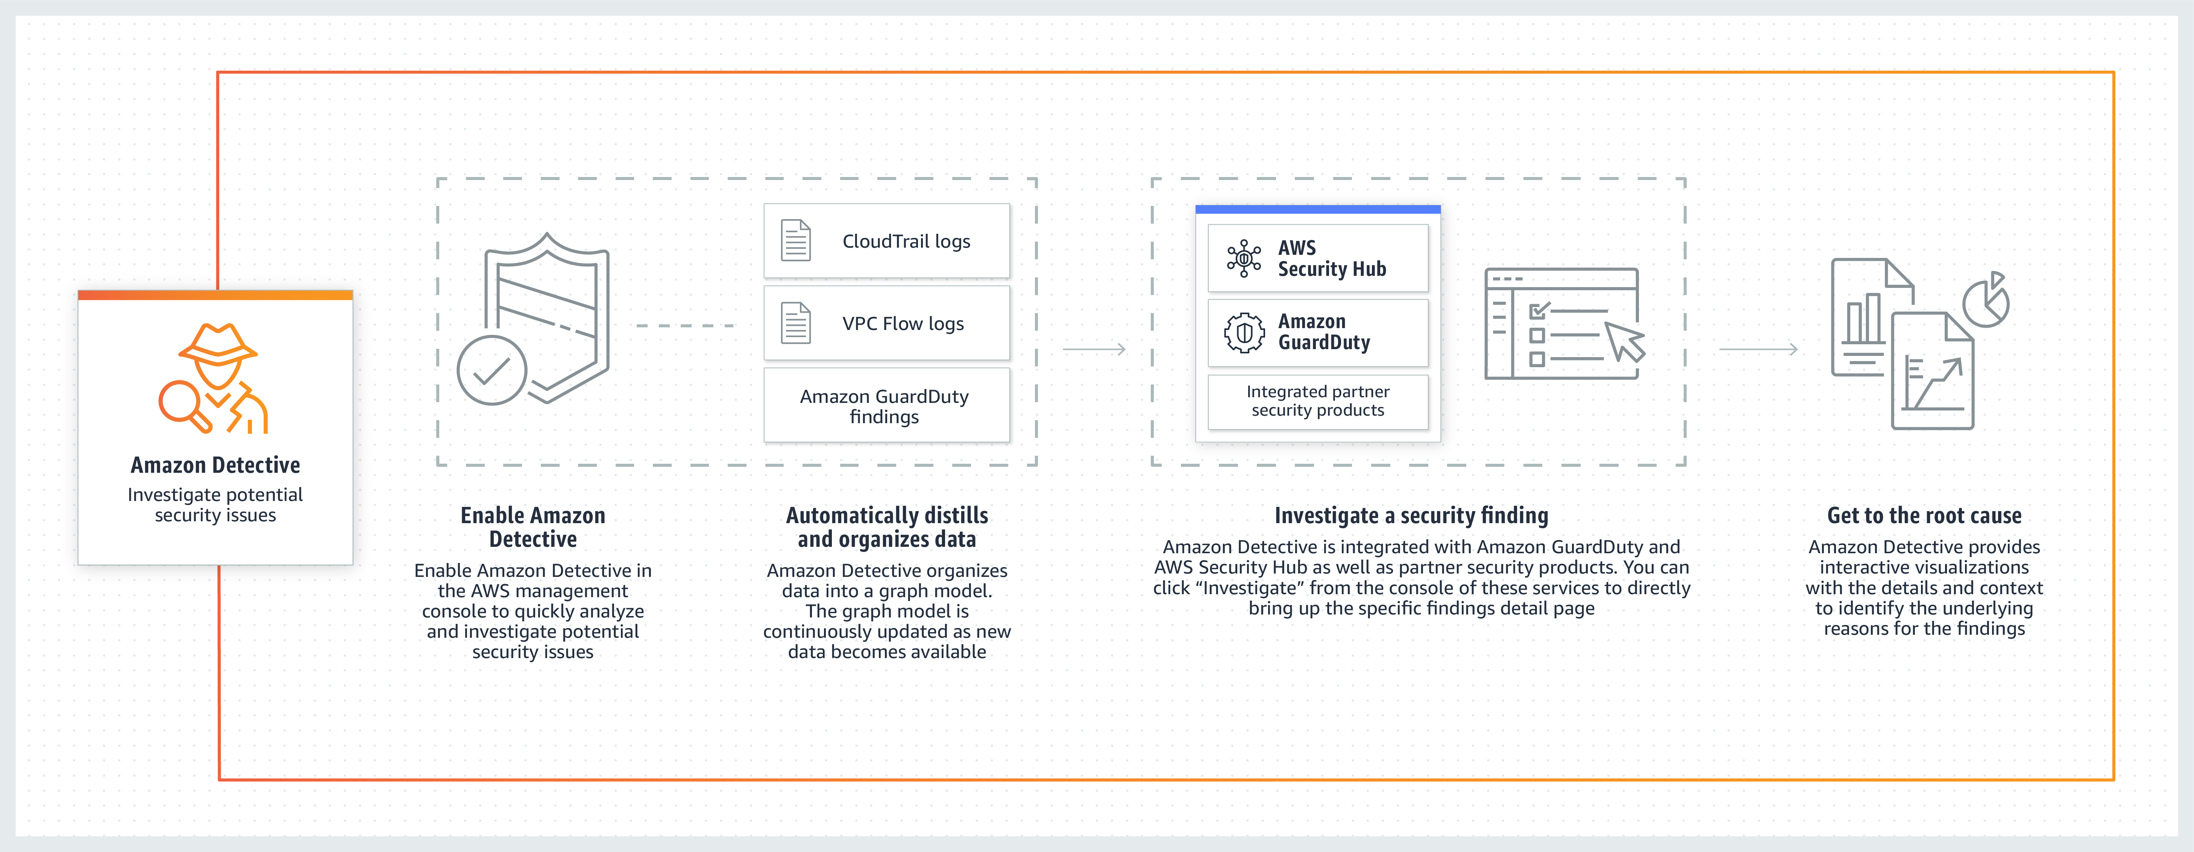
AWS Detective: High Level

Slide 98
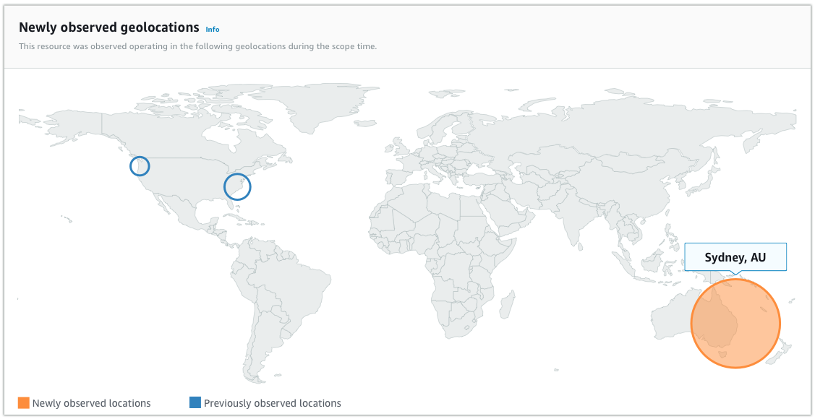
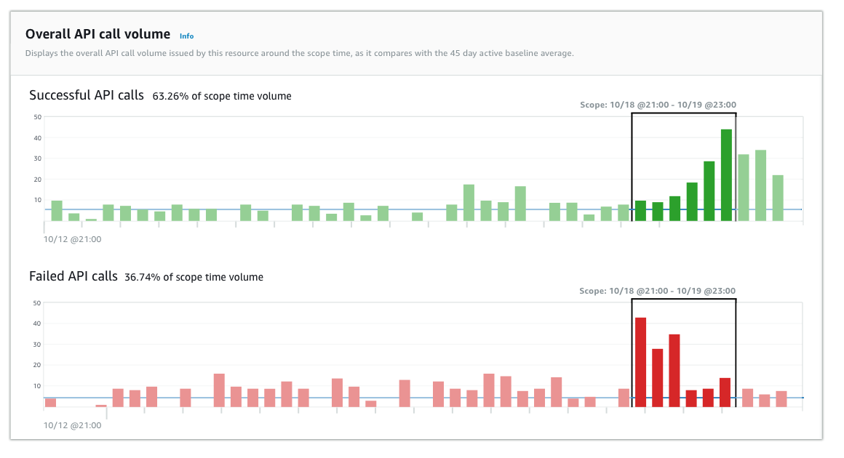
AWS Detective: Interactive visualizations

Slide 99
AWS Detective: Integration
Integrated with GuardDuty and Security Hub
Single click (“Investigate”) from either of these services exposes Detective insights with relevant activity for the finding or suspicious activity
Requires no software installation or configuration
Requires no enabling, ETL, storage, or transfer of data sources
Integrated with Organizations

Slide 100
Poll (single answer)
How is the depth of the information presented?
Goldilock’s zone – “juuust right”
Too deep
Too shallow

Slide 101
Activity 5: Automated WAF rule updates via GuardDuty finding notification
Create a CloudWatch Event rule to notify of malicious GuardDuty finding
Integrate CW Event with Lambda
Automate Lambda updating of AWS WAF filter rules in CloudFront

Slide 102
Break! (10 mins)

Slide 103
S8: Governance, Regulation, and Compliance (GRC) Automation
GRC concerns in a cloud environment.
Review of AWS GRC services (Shield, Macie, Inspector, Security Hub).
Deeper look into Inspector and Macie.
Review of GRC Lab.

Slide 104
Poll (single answer)
How frequently are you involved in GRC-related issues?
Never
Once/twice a quarter
Once/twice a month
Once twice a week
Every. Damn. Day.

Slide 105
GRC Concerns in a cloud environment 1
Ingress / egress data transfer to / from cloud
VPN (many options), TLS (every service supports, some mandate), DirectConnect (dedicated fiber)
Data storage in cloud
Native encryption (if service supports, GRC req’s allow)
KMS encryption – meets 95%+ of GRC needs
Cloud HSM encryption – for the other 5%
Client-side encryption – always an option!
AWS likes to say “Move the attacker off of your infrastructure and onto ours”

Slide 106
GRC Concerns in a cloud environment 2
Identities
Federation, SSO [esp SAML] preferred for internal
Cognito preferred for end-users
Audit trails, Config Management
Always turn on CloudTrail!
Always turn on Config!
Logging
Always turn on all possible logs – even if not needed
Service-level support for specific GRC requirements!
Always. Hire. Independent. Auditors. ALWAYS!

Slide 107

AWS Shield
“AWS managed, always-on DDOS protection”
Two levels of service:
Standard (FREE)
Automatically deployed on CloudFront and Route53
Protects against all known L3 & L4 attacks
Advanced (Paid)
Selectively deploy on ALB, NLB, EIP, EC2, Global Accelerator, R53, and CloudFront (but NOT API Gateway)
Protections beyond standard, including L7 & WAF integration
24x7 Shield Response Team (SRT), who can help author WAF rules
Bill protection (reimbursement) for DDOS-incurred charges

Slide 108

Amazon Macie
“AWS managed data security and data privacy service that uses machine learning to discover and protect sensitive data”
Currently only works with S3 (rumors abound of expansion)
Detects “known” sensitive data like PII, PCI, etc
Allows detection of “custom” sensitive data
Alerts on:
Unencrypted buckets
Publicly accessible buckets
Buckets shared w/other Accounts
Works with Organizations

Slide 109
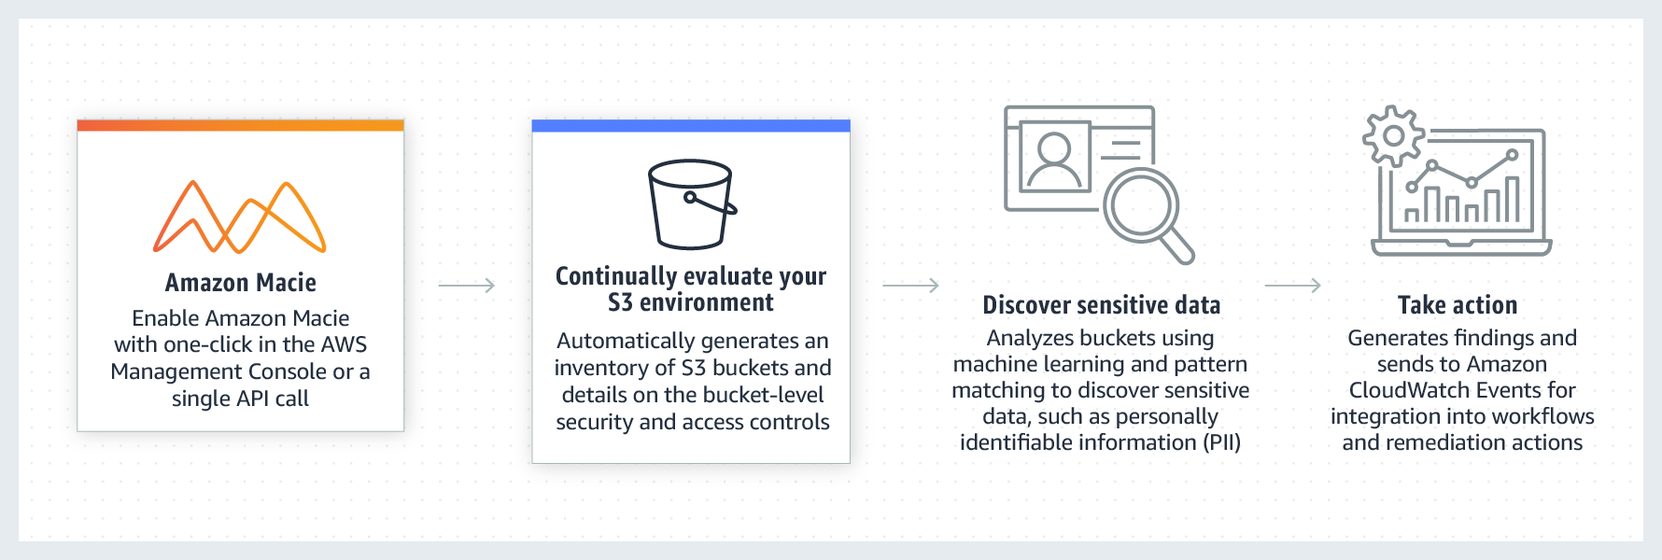
Amazon Macie: High Level

Slide 110
Amazon Macie: Use cases
Analyze OTHER AWS data.
“Currently only works with S3” …But it’s really trivial to copy data from other AWS services into S3
Snapshots from RDS, EBS, DDB, etc
API Copy command from other services
Identify sensitive data during migrations
Create S3 staging area for ingress data & perform Macie analysis there
Maintain regulatory compliance
Schedule data analysis to be once, daily, weekly, etc.
Scan reports contain all findings, buckets, objects, timestamps…

Slide 111
Inspector: EC2 Internals
Security group
“point & click firewall”
CW Agent
AWS Systems Manager
Amazon CloudWatch
SSM Agent
NAT gateway
Inspector
Elastic network interface
EC2 Instance
H/W ½ (instance type)
S/W ½ (Amazon Machine Image) or “AMI”
May have local (ephemeral) disk
At least one NIC card (ENI)
EBS Volume
Elastic IP address
Amazon Inspector

Slide 112
Amazon Inspector
“Automated , continual vulnerability management at scale”
Agent-based (white box) and agent-less (black box)
Works with EC2, Containers
Calculates contextualized “risk score” based on CVE info
Has own console, and Security Hub integration
Can be used with EventBridge to automatically generate tickets and start remediation workflows
Notes:
https://aws.amazon.com/inspector/?nc=sn&loc=0
112

Slide 113

AWS Security Hub
“AWS managed continuous security findings aggregator, dashboard, and automated incident response tool”
Ingests findings and logs from 6+ other AWS services to provide one-stop shopping for all security issues
Works with Organizations and EventBridge
Extensive partner integrations to 3rd party security products
Standardized data format (AWS Security Findings Format or ASFF)
Provides automated, continuous AWS Foundational Security Best Practices standard checks
…and lots more
Notes:
Automated, continuous security best practice checks:
“Security Hub provides you with a set of automated security controls called the AWS Foundational Security Best Practices standard. This is a highly curated set of security best practices vetted by our AWS security experts that either run continuously whenever there are changes to the associated resources or on a set periodic schedule. Each control has a specific severity score to help you prioritize your remediation efforts. We recommend that this standard is enabled across all accounts and regions, and we are continuously updating it with new controls and additional service coverage.”
113

Slide 114
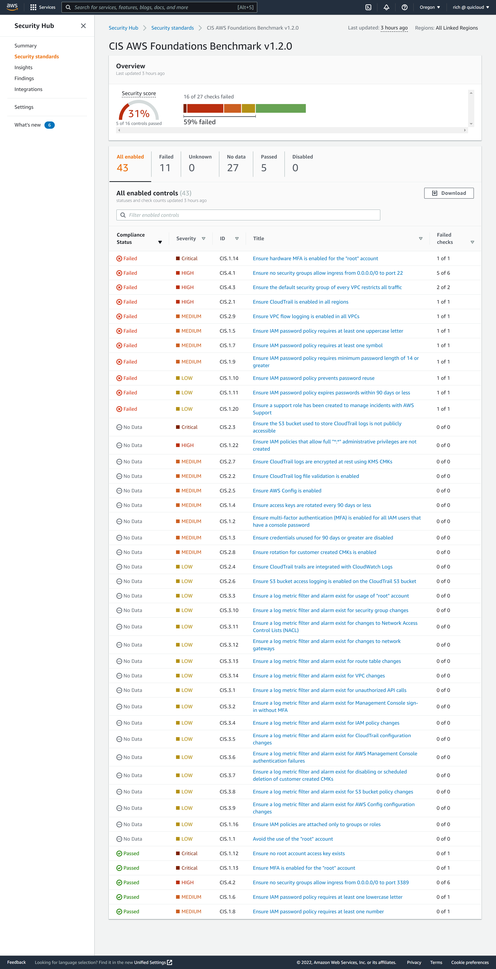
AWS Security Hub: Dashboard
Notes:
Automated, continuous security best practice checks:
“Security Hub provides you with a set of automated security controls called the AWS Foundational Security Best Practices standard. This is a highly curated set of security best practices vetted by our AWS security experts that either run continuously whenever there are changes to the associated resources or on a set periodic schedule. Each control has a specific severity score to help you prioritize your remediation efforts. We recommend that this standard is enabled across all accounts and regions, and we are continuously updating it with new controls and additional service coverage.”
114

Slide 115
Lambda & Security Hub Integration!
Remediate Security Hub findings
Security, Orchestration, Automation, Response (SOAR) Workflows
Dynamically update WAF/SG/DNS policies via Firewall Manager Automations
Alert / remediate Access Analyzer or CloudTrail issues
EC2 telemetry via Amazon Inspector
Trusted Advisor recommended best practices
AWS Security Hub Automated Response and Remediation

Slide 116
Activity 6: Automated EC2 and S3 scanning and remediation using Inspector, Macie, and Lambda action
EC2 Inspector Classic telemetry configuration
EC2 Inspector Classic assessment template run, remediation, and notification demo
Macie configuration
Macie integration with Lambda
Validation of Macie automation via Lambda hooks

Slide 117
EOD Q&A

Slide 118
Schedule – Day 4
S9: DevOps Automation (75 mins)
BREAK: 10 minutes
S10: Review of DevOps capstone lab (20 mins)
A7: ACTIVITY: Setting up a fully automated DevOps pipeline using Lambda triggers (105 mins)
Break (10 mins)
Course wrap up & next steps (20 mins)

Slide 119
Poll (single answer)
Where is your company/department in your DevOps journey?
HA! We haven’t even started!
Some proof-of-concepts are in play
Some products are actively in CI
Some products actively in CI/CD
Many products actively in CI
Many products actively in CI/CD
Most products actively in CI
Most products actively in CI/CD

Slide 120
S9: DevOps Automation
Review of DevOps pipelines & the SDLC.
Review of AWS Developer Tools (CodeCommit, CodeBuild, CodeDeploy).
Overview of automation hooks in DevOps pipelines.
Deeper dive into innovative, practical DevOps automation capabilities.
Review of DevOps lab.

Slide 121
Poll (single answer)
How is the pace of the class?
Goldilock’s zone – “juuust right”
Too fast
Too slow

Slide 122
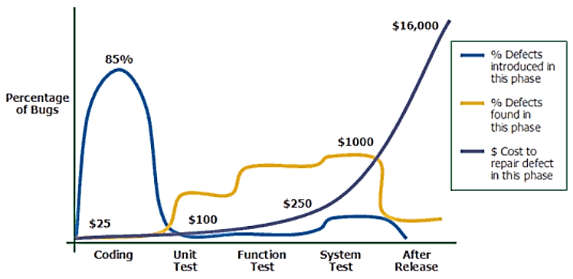
“Shift left” – the whole point of CI/CD
Source: Applied Software Measurement, Capers Jones, 1996
Notes:
Image credit: https://medium.com/at-internet/how-to-combine-testing-and-agile-method-2a990d70108f
…and if you want to read more from Capers Jones, here’s a link to his catalog on Amazon.com: https://www.amazon.com/Capers-Jones/e/B000APTHHW%3Fref=dbs_a_mng_rwt_scns_share
122

Slide 123

The DevOps Pipeline & the SDLC
DEV
OPS
Notes:
Image credit: https://medium.com/swlh/how-to-become-an-devops-engineer-in-2020-80b8740d5a52
123

Slide 124


AWS Services in the DevOps Pipeline
CodeCommit
CodeDeploy
…possibly w/Cloud9
…or Beanstalk
…or SSM
…or fully-baked AMI
…or EKS/ECS Containers
…or CloudFormation
…or OpsWorks (Chef/Puppet)
DEV
OPS
What services can help us here & here?
CodeBuild
Notes:
Image credit: https://medium.com/swlh/how-to-become-an-devops-engineer-in-2020-80b8740d5a52
124

Slide 125
AWS CodeCommit
“AWS managed git-compliant source control”
Full, native git command & graphical toolset support
IAM (can authenticate IAM identities), CloudWatch, and CloudTrail integration
Code stored in S3 (99.999999999% durability), metadata in DDB
All data encrypted at rest and in transit
Full API, SDK, Console support
SNS notifications on repository events

Slide 126
AWS CodeBuild
“AWS managed Jenkins-compliant build server”
Prepackaged and customized build tools, environments and runtimes
IAM, CloudTrail, and CloudWatch support

Slide 127
AWS CodeDeploy
“AWS managed, serverless automated code deployment service”
Language, architecture agnostic
Deploys to EC2, Fargate, Lambda or on-prem
In-place, and blue/green (rolling, canary, all-at-once) deployment types supported
Can run actions, test, health & other verifications, and optional rollback & redeploy – all automated
Sends SNS notifications for various lifecycle events

Slide 128




Other AWS “Code”* Services
AWS CodePipeline
AWS CodeStar
AWS Command Line Interface (AWS CLI)
AWS Toolsand SDKs

Slide 129
Automation hooks in DevOps pipeline
Type | Where run | Attributes | Examples
Pre-commit | Dev machine | Run FAST, comprehensive, TDD driven | SCA, secrets check
Commit-time | Commit svr(s) | Repeat many tests from pre-commit + new | SAST, light security testing
Build-time | CI/build svr(s) | Sanity checks, config, cheap | Artifact hardening
Test-time | Test/stage env | More in-depth | Regression, Integration, load, UAT
Pre-deploy | CI/build svr | Set up deploy env | Cfg mgmt., agent install
Deploy | Prod env | Validate deployment | Health, vulnerability scan

Slide 130
Automation hooks in DevOps pipeline
CodeCommit
CodeDeploy
Secrets (AK/SK, etc) sniff
Static Code Analysis
Look up Config (tag-based?)
…and more!
Validate health
Vulnerability scan
Threat intelligence
Install security agents
DEV
OPS
CodeBuild
Malicious code detection
Enforce WAF rules, SG policies, ELB security
SAST tools
Enforce VPC setup
Build deployment artifacts
Pre-deploy security scan
Notes:
Image credit: https://medium.com/swlh/how-to-become-an-devops-engineer-in-2020-80b8740d5a52
Some further reading on building a DevSecOps pipeline: https://medium.com/@SW_Integrity/building-your-devsecops-pipeline-5-essential-activities-e5e4ca16344e
SAST = Static App Security Testing tools https://owasp.org/www-community/Source_Code_Analysis_Tools
130

Slide 131

AWS CloudFormation
“Templating engine to model, provision, and manage AWS and 3rd party resources by treating infrastructure as code”
Used to Create, Update, Delete stacks of resources atomically
Includes a CLI, CDK (Cloud Development Kit), and SAM (Serverless Application Model) capabilities
Templates authored in JSON or YAML
Supports ChangeSets to preview changes prior to execution
Supports dependency chaining (DependsOn attribute)
Automatically rolls back entire stack on failure of creation of any single component (configurable)

Slide 132
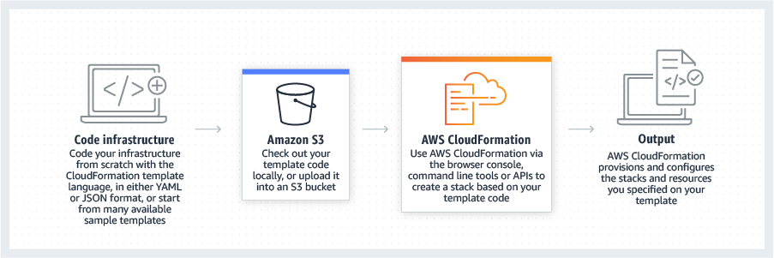
CloudFormation: High Level

Slide 133
Poll (single answer)
What’s your experience with CloudFormation?
Zero
Tinkered a bit
Fairly proficient
Quite advanced

Slide 134
Break! (10 mins)

Slide 135
S10: Review of DevOps Capstone Lab
Instructor will walk you through salient parts of lab

Slide 136
Activity 7: Setting up a fully automated DevOps pipeline using Lambda triggers
Review the CloudFormation template resources (S3, CodeCommit, CodePipeline, CodeBuild, CloudWatch Events)
Create a serverless framework baseline with CloudFormation
Extending baseline with Lambda triggers
Tightening roles and security profiles for the real world
Final review and conclusion

Slide 137
Break! (10 mins)

Slide 138
Poll (single answer)
Did we deliver what you signed up for?
Yes
Kindof
Not really

Slide 139
Course wrap-up and next steps
Any final questions?
Evaluations!
Course code, slides, activity guide:
git clone https://github.com/rich-morrow/autom8d-deepdive
rich@quicloud.com if you have questions / comments
Connect with me on LinkedIn:
http://linkedin.com/in/cloudguy

